Slide 1
Overdraft Facility

Slide 2
Overdraft Facility
Overdraft Facility is a financial instrument in which you can withdraw money from your savings or current account, even if your account balance is zero. This feature is provided by almost every financial institution, including banks and NBFCs.
Overdraft facility a type of short-term loan to be repaid in defined tenure as required by the financial institutions. Lenders shall levy interest rate that the borrower needs to repay, as per the bank’s terms and conditions. The type of interest rate offered by lender is fixed and not floating.
Some customers are pre-entitled to avail the overdraft facility by the lender while some have to take approval. When the pre-entitled customers withdraw extra money from their account, their account balance becomes negative and the overdraft facility is activated automatically. The customers who require the lender’s approval to avail the temporary overdraft facility have to submit their request to their lender either in writing or through official website.

Slide 3
How does Overdraft Facility work
If you get an overdraft account sanctioned from the bank then you will receive the requested overdraft amount just like you receive a loan amount from the bank. If you are pre-approved for the overdraft facility, whenever you need funds, you can withdraw from your bank account and it will go into overdraft. You can overdraw funds through your account up till an agreed limit. By utilizing the overdraft facility you basically increase the outstanding on your bank account; when you deposit funds, the outstanding decreases. From the time you borrowed until you repaid, you will be charged interest by your bank.
In an overdraft, you can repay money to the lender, fully or partially both, whenever you want to. After repaying whenever you have money, you can again withdraw money from your account as per your need until the limit of the overdraft is reached.
The borrower takes an overdraft against his/her assets as collateral then it is a secured overdraft. These assets can be the funds in your account and even your house, insurance policies, fixed deposits (FDs), shares, bonds etc. Also note that the interest rates charged and overdraft amounts sanctioned by banks vary depending on the collateral.
Interest on the overdraft amount is calculated daily because overdraft amount is not repaid as per a set schedule. The borrowed amount can be repaid without prior intimation by the borrower. Just depositing funds in your bank account reduces your outstanding balance and thus reduces your overdraft amount. So, interest applicable on the borrowed amount needs to be calculated daily since the borrowed amount ledger can change daily.

Slide 4
Features of Overdraft Facility
Approved Credit Limit
Overdraft is awarded over a predetermined limit. This limit can be different for each borrower
Interest Rate
Interest rate is charged on the amount of overdraft used. It is calculated on daily basis and it is billed to the account at month-end. If you default on paying the overdraft as per set schedule, the interest amount will be added to the principal amount at month-end and then interest will be calculated on new principal
Nil Prepayment Charges
Whenever you want to prepay a loan, usually a prepayment charge is levied. However, this is not the case with the overdraft facility. When you repay the amount borrowed through overdraft you do not pay prepayment charges. Also you need not repay the Overdraft amount in EMIs. You can repay the borrowed amount cumulatively

Slide 5
Features of Overdraft Facility
Repayment is done not through EMI
Repay the overdraft whenever you have the money. You do not have to repay the overdraft amount like you repay a loan. You do not have to repay in Equated Monthly Instalments (EMIs). You can repay whatever amount you like whenever you like. However, if the lender demands a repayment, then you will have to fulfil that demand
Minimum Monthly Payment
Overdraft has no minimum monthly repayment however the amount you owe should be in the overdraft limit. You should not delay overdraft repayment for long, as it affects your credit score
Joint Borrowers are allowed on Overdraft
If you take an overdraft jointly then you and your joint applicant are both, in effect, responsible for the entire debt. Irrespective of the proportion of overdraft borrowed, both the applicants are responsible for the timely repayment of the overdraft. This means that if one of the borrowers is unable to pay/defaults, then the other borrower has to pay the entire amount.

Slide 6
Types of Overdraft Facility
Overdraft Against Property
Overdraft facility is offered against your house as collateral. Overdraft is also offered to home loan customers who are looking for funds to settle their existing home loan repayments. Before approving the house as collateral, the assessment, the valuation and the survey of the property is done. Overdraft funds given against property as collateral are not disbursed immediately because of the same. The sanctioned overdraft amount is usually up to 40%-50% of the property’s worth. Your credit history and repayment capacity is also considered while granting overdraft against house as collateral.
Overdraft Against Fixed Deposit
The overdraft sanctioned against Fixed Deposits as collateral is easy in comparison to getting an overdraft sanctioned by keeping your home as collateral. One of the reasons is that property evaluation takes time. In any case, overdraft against FD is preferable for the lender too, as the customer’s FD account is with the lender and the lender knows the customer much better. If you avail an overdraft against your fixed deposit, then you are eligible for a higher percentage of sanctioned amounts, approx. 75%. Interest rate charged is also less if you keep FD as collateral. Usually banks charge 2% more interest than the interest you are earning from the said fixed deposit if you keep the FD as collateral.

Slide 7
Types of Overdraft Facility
Overdraft Against Equity
Equity is not preferred as an option for collateral however it is possible to attain overdraft facility through it. The reason being that equity is dependent on the market and thus its value fluctuates. This is why the percentage sanctioned for overdraft against equity as collateral is less.
Overdraft Against Salary
Banks offer overdraft for salaried individual against the salary too. You can get an overdraft limit up to 2-3 times of your salary but that may vary from bank to bank. To avail such an overdraft you need to have a salary account with the said bank. Such facility is also called a short-term loan facility.

Slide 8
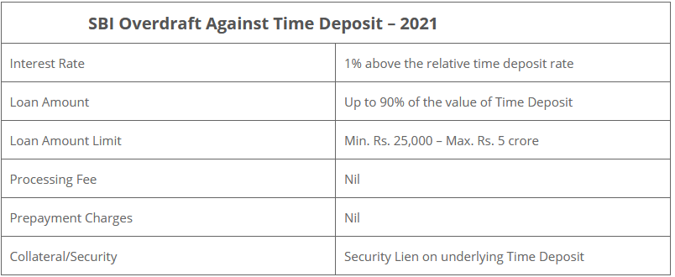
Overdraft Facility Charges

Slide 9
Video Links
SBI Mobile Banking Apply Overdraft Facility - https://www.youtube.com/watch?v=lkeyOjuzz3w.
Kotak Bank Apply Overdraft Facility
https://www.youtube.com/watch?v=5Exkn1H2T6A&t=16s.

